Slide 1

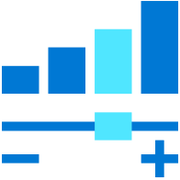
TSI to ADX Migration

Slide 2
Agenda
Lesson 1: Why TSI to ADX migration
Lesson 2: Understanding ADX
Lesson 3: Migrating from TSI to ADX
Lesson 4: Finalizing the migration
Notes:
https://microsoft.sharepoint.com/teams/CSUDataAICommunityIPLibrary/_layouts/15/Doc.aspx?sourcedoc=%7B318D6B89-8C3F-41F6-8F1A-7F737AE7567B%7D&file=CIP_Name_Agenda.docx&action=default&mobileredirect=true&share=IQGJa40xP4z2QY8af3N651Z7AXwr0sZRYb0IxoCqtkhi1QQ&cid=8d6e2bf3-6b6b-4291-a2b6-481656135131
Lesson 1: 30 mins
Lesson 2: 60 mins
Lesson 3: 60 mins
Lesson 4: 45 mins

Slide 3
Why Migrate
Lesson 1

Slide 4
Objectives
After completing this Learning, you will be able to understand:
Announcement
Path, options & timelines
What is possible and what is not
Gather TSI info

Slide 5
Time Series Insights (TSI) Announcement
No longer supported after March 2025.
Published docs (https://aka.ms/tsi2adx) regarding deprecation and migration.
Note:
If you are unable to migrate to Time Series Insights to Azure Data Explorer by 31 March 2025, your Time Series Insights resources will be automatically deleted.
You’ll be able to access Gen2 data in your storage account.
However, you’ll only be able to perform management operations (such as updating storage account settings, getting storage account properties/keys, and deleting storage accounts) through Azure Resource Manager.
For Gen1 data, if you have a support plan, please create a support ticket to retrieve your Gen1 data. We will keep your Gen1 data until 30 April 2025.

Slide 6
Feature Comparison
Feature | TSI | ADX
Ingestion | Hubs, limit 1 MB/s | Many data connection methods, SDKs, APIs, No limits (scalable), 200MBs per second per node benchmarked on 16-cores.
Storage & Retention | Warm – multitenant ADX | Cold – Azure Blob storage distributed columnstore, with Hot - Highly optimized SSD (locally on compute nodes).
Formats | JSON | JSON, CSV, Avro, Parquet, ORC, TXT and more.
Querying | TSQ | KQL, SQL
Visualization | TSI Explorer, PBI | PBI, ADX Dashboards, Grafana, Kibana, plus more via ODBC/JDBC
ML | n/a | Built-in plugins, R, Python to train and score data. Native forecasting, anomaly detection, and clustering.
PBI Connector | Public preview | Optimized native PBI connector (GA), supports Direct Query, Import mode, parameters and filters.
Export | Parquet in Blob | Supports continuous export to Azure storage, and External tables to read exported data
HA/DR | Depends on config | HA SLA of 99.9%, AZ supported, built on durable Azure Blob storage.
Security | Private link for incoming, but open for storage and hubs | VNet injection, Private Link, Encryption at rest with customer managed keys
RBAC & RLS | Limited, no RLS | Granular, RLS and DM supported
Notes:
First of all:
TSI is Software as a Service (SaaS).
ADX is Platform as a Service (PaaS) – more control and highly scalable (with today’s battle tested workloads of 85 PB per day), purposely built for time series data. Built in 2015 and has been in GA since 2019.

Slide 7
Migration Paths
TSI Gen1
Create ADX Cluster
Setup parallel ingestion from hubs to ADX
Continue ingesting data until retention or fixed period is met
Start using ADX Cluster
Delete TSI Env.
Detailed FAQ: How to migrate TSI Gen1 to ADX
TSI Gen2
Create ADX Cluster
Redirect data ingestion to ADX
Import TSI cold data using lightingest
Start using DX Cluster
Detailed FAQ: How to migrate TSI Gen2 to ADX

Slide 8
Demo 1*
Understand the TSI Env - TSI Explorer (azure.com)
Gather details
Blob folder, lateness in data) - ie. Data arriving later than expected
Give access
* Estimate 10 minutes
Notes:
INSTRUCTOR STEPS: link to Demo wiki or readme
Map: https://microsoft-my.sharepoint.com/:w:/p/bwatts/EYPhRAHN6FRIhpvPJCVyqNEBsAzqjGeA0hGy9vKAwSjFXg
Ref:
https://azure.microsoft.com/services/time-series-insights/
(Gen1 Demo) https://insights.timeseries.azure.com/demo#
[REQ] Join SG: https://idwebelements/GroupManagement.aspx?Group=adxdemoenv&Operation=join
Link to env in Ibiza
Total size of Cold Parquet blobs (compressed)
env-xtluse2s88-pusher-0 - Microsoft Azure
46 GB
env-ingress-stress-l1-s03-0 - Microsoft Azure
35 TB
Corresponding storage accounts:
xtluse2s88pushersa - Microsoft Azure
l1stressteststorages03 - Microsoft Azure
TSI Explorer (azure.com)

Slide 9
ADX Overview
Lesson 2
Notes:
Lesson 2
Understanding ADX > Overview module of ADX for IoT
Explain that ADX is the best suited option.
Explain the differences between TSI and ADX. Highlight the “breaking” differences and how these will be handled. Here, we can extend the earlier discussion of TSI as Software as a Service (SaaS). Instead, ADX, which is a Platform as a Service (PaaS) – more control and highly scalable (with today’s battle tested workloads of 85 PB per day), purposely built for time series data.
Demo 2 (ADX and how it works?) > option ADXIoTAnalytics/M02-Demo4-IoT.kql at main · Azure/ADXIoTAnalytics (github.com)
Show IoT demo of ADX explaining what you can do with ADX. IoT demo must include some of the timeseries analysis functions that TSI provided
Emphasis on Time Series render & dashboard

Slide 10
Objectives
After completing this Learning, you will be able to understand:
Common use-cases
What ADX is
Architecture
Batching vs streaming ingestion
Web UI capabilities
Extensibility
How ADX is Enterprise Ready
Notes:
Lesson 2
Understanding ADX > Overview module of ADX for IoT
Explain that ADX is the best suited option.
Explain the differences between TSI and ADX. Highlight the “breaking” differences and how these will be handled. Here, we can extend the earlier discussion of TSI as Software as a Service (SaaS). Instead, ADX, which is a Platform as a Service (PaaS) – more control and highly scalable (with today’s battle tested workloads of 85 PB per day), purposely built for time series data.
Demo 2 (ADX and how it works?) > option ADXIoTAnalytics/M02-Demo4-IoT.kql at main · Azure/ADXIoTAnalytics (github.com)
Show IoT demo of ADX explaining what you can do with ADX. IoT demo must include some of the timeseries analysis functions that TSI provided
Emphasis on Time Series render & dashboard

Slide 11
ADX is Best Suited
Analytics storage engine
Optimized
Native support
Low-latency
Human friendly query language
Now also in Synapse
for time stamped data: logs, time series, telemetry
for free text, structured and semi-structured data
Near real-time data analytics at scale
for ad-hoc analytics
Notes:
So Kusto (Azure Data Explorer). What is it?
It’s an Analytics storage engine: It stores the data it ingested. It stores it in a highly optimized format in order to provide the extreme and efficiency that is needed for this type of workload. The new thing that we published last year is that is also available in Synapse and it’s going to be there as a core part of the Synapse Analytics road map.
It’s super optimized for exactly this workload. Time stamped data, activity data, logs in the row, time series, and other telemetry data. Being able to ingest it, make it query-able. Derive insights for that and then continue to process it. Create views on top of it, apply schema on read and some even materialized views in order to provide more efficient cubes on top of it later.
Another element is the native support for free text, structured and semi-structured data. The ability to deal with JSON natively, extract JSON. Search in text and this is a perfect fit for this workload because of the dynamic nature of the data, data has to be encoded in free text and JSON very often.
We talked about the latency. Both low latency for getting data in and for running queries interactively. When we’re talking about the velocity, we are capable of ingesting more than 200 MBs/second per server that’s deployed in the back-end in order to provide that low-latency ingestion and query-able data.
And the last point is that because of the accelerating rate of business questions and unpredictable business questions that we need to answer, we must have humans be capable of doing this themselves. We can’t lean on reports some person in the IT department is preparing, designing and publishing. People need to be able to answer questions themselves.
For example, a Retail customer’s inventory procurement meeting ask the providers in real time: What their status is. What their inventory is. How many of this, how many of that. In a way that requires them to provide real time answers on very diverse questions. This is the type of adhoc analytics that we are here to provide.

Slide 12
ADX Key Differences
Experience | TSI | ADX
Service kind | SaaS - simple | PaaS - deep control and scalability
Models | Hierarchies | Folders, Tables, Data, UDF, Views
User-Interface | TSI Explorer UI | ADX Web-UI, Kusto Explorer, SDKs, Embedding
AI | n/a | Built-in ML plugins, Kqlmagic

Slide 13
Common use cases across verticals
Retail
Financial
Oil/Gas & Energy
Security
Web Analytics, IoT Analytics
Audit Logs
Industrial IoT, Historian, Time Series, Grid analytics
Security Analytics, Threat Detection, SIEM
Healthcare
Advertising
Media Entertainment
Automotive
IoT device
Analytics
Personalized offers, campaign management
Content Delivery Network analytics, Viewer experience analytics, Live Event Analytics
Manufacturing, Connected cars, Fleet management
Central Observability (Logs, Traces, Metrics) and Time Series
Notes:
There are various Log and Time Series across the industries to:
Consolidate and correlate logs and events data across on-prem, cloud, 3rd party
Replace legacy log search solutions
Accelerate your AI Ops journey (pattern recognition, anomaly detection, forecasting, etc.)
Building IoT Analytics

Slide 14
What is Azure Data Explorer?
Fully managed
High-performance
Big data analytics platform
Analyze high volumes of data in near real time
End-to-end solution for data ingestion
Query, visualization, and management
Useful for log analytics, time series, IoT, and general-purpose exploratory
Notes:
By analyzing structured, semi-structured, and unstructured data across time series, and by using Machine Learning, Azure Data Explorer makes it simple to extract key insights, spot patterns and trends, and create forecasting models. Azure Data Explorer is scalable, secure, robust, and enterprise-ready, and is useful for log analytics, time series analytics, IoT, and general-purpose exploratory analytics.

Slide 15
What makes ADX unique?
Data velocity, variety, and volume
User-friendly query language
Advanced analytics
Easy-to-use wizard
Versatile data visualization
Automatic ingest, process and export
Notes:
Data velocity, variety, and volume
With Azure Data Explorer, you can ingest terabytes of data in minutes in batch or streaming mode. You can query petabytes of data, with results returned within milliseconds to seconds. Azure Data Explorer provides high velocity (millions of events per second), low latency (seconds), and linear scale ingestion of raw data. Ingest your data in different formats and structures, flowing from various pipelines and sources.
User-friendly query language
Query Azure Data explorer with the Kusto Query Language (KQL), an open-source language initially invented by the team. The language is simple to understand and learn, and highly productive. You can use simple operators and advanced analytics. A Kusto query is a read-only request to process data and return results. The request is stated in plain text, using a data-flow model that is easy to read, author, and automate. Kusto queries are made of one or more query statements. KQL is case-sensitive for everything – table names, table column names, operators, functions, and so on.
Advanced analytics
Use Azure Data Explorer for time series analysis with a large set of functions including: adding and subtracting time series, filtering, regression, seasonality detection, geospatial analysis, anomaly detection, scanning, and forecasting. Time series functions are optimized for processing thousands of time series in seconds. Pattern detection is made easy with cluster plugins that can diagnose anomalies and do root cause analysis. You can also extend Azure Data Explorer capabilities by embedding python code in KQL queries.
Easy-to-use wizard
The ingestion wizard makes the data ingestion process easy, fast, and intuitive. The web UI provides an intuitive and guided experience that helps you ramp-up quickly to start ingesting data, creating database tables, and mapping structures. It enables one time or a continuous ingestion from various sources and in various data formats. Table mappings and schema are auto suggested and easy to modify.
Versatile data visualization
Data visualization helps you gain important insights. Azure Data Explorer offers built-in visualization and dashboarding out of the box, with support for various charts and visualizations. It has native integration with Power BI, native connectors for Grafana, Kibana and Databricks, ODBC support for Tableau, Sisense, Qlik, and more.
Automatic ingest, process, and export
Azure Data Explorer supports server-side stored functions, continuous ingest, and continuous export to Azure Data Lake store. It also supports ingestion time-mapping transformations on the server side, update policies, and precomputed scheduled aggregates with materialized views.

Slide 16
Major components of ADX
An ADX cluster does all the work to ingest, process, and query your data. The clusters are auto-scalable according to your needs. It stores the data on Azure Storage and caches some of this data on the cluster compute nodes to achieve optimal query performance.
What is an ADX cluster?
Each ADX cluster can hold up to 10,000 databases and each database upto 10,000 tables.
The data in each table is stored in data shards also called “extents”.
All data is automatically indexed and partitioned based on the ingestion time.
There are no primary foreign key constraints or any other constraints, such as uniqueness.
The logical structure of a database is similar to many other relational databases. An ADX database can contain:
Tables: Made up of a set of columns. Each column has one of nine different data types.
External tables: Tables whose underlying storage is in other locations such as Azure Data Lake.
Notes:
Data velocity, variety, and volume
With Azure Data Explorer, you can ingest terabytes of data in minutes in batch or streaming mode. You can query petabytes of data, with results returned within milliseconds to seconds. Azure Data Explorer provides high velocity (millions of events per second), low latency (seconds), and linear scale ingestion of raw data. Ingest your data in different formats and structures, flowing from various pipelines and sources.
User-friendly query language
Query Azure Data explorer with the Kusto Query Language (KQL), an open-source language initially invented by the team. The language is simple to understand and learn, and highly productive. You can use simple operators and advanced analytics. A Kusto query is a read-only request to process data and return results. The request is stated in plain text, using a data-flow model that is easy to read, author, and automate. Kusto queries are made of one or more query statements. KQL is case-sensitive for everything – table names, table column names, operators, functions, and so on.
Advanced analytics
Use Azure Data Explorer for time series analysis with a large set of functions including: adding and subtracting time series, filtering, regression, seasonality detection, geospatial analysis, anomaly detection, scanning, and forecasting. Time series functions are optimized for processing thousands of time series in seconds. Pattern detection is made easy with cluster plugins that can diagnose anomalies and do root cause analysis. You can also extend Azure Data Explorer capabilities by embedding python code in KQL queries.
Easy-to-use wizard
The ingestion wizard makes the data ingestion process easy, fast, and intuitive. The web UI provides an intuitive and guided experience that helps you ramp-up quickly to start ingesting data, creating database tables, and mapping structures. It enables one time or a continuous ingestion from various sources and in various data formats. Table mappings and schema are auto suggested and easy to modify.
Versatile data visualization
Data visualization helps you gain important insights. Azure Data Explorer offers built-in visualization and dashboarding out of the box, with support for various charts and visualizations. It has native integration with Power BI, native connectors for Grafana, Kibana and Databricks, ODBC support for Tableau, Sisense, Qlik, and more.
Automatic ingest, process, and export
Azure Data Explorer supports server-side stored functions, continuous ingest, and continuous export to Azure Data Lake store. It also supports ingestion time-mapping transformations on the server side, update policies, and precomputed scheduled aggregates with materialized views.

Slide 17
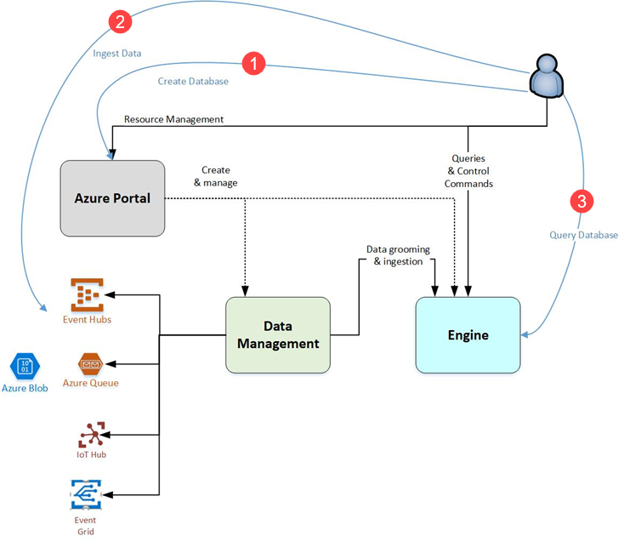
Working with ADX
Create Database
Ingest Data
Query Database
Visualize results
Notes:
Create database: Create a cluster and then create one or more databases in that cluster. Each Azure Data Explorer cluster can hold up to 10,000 databases and each database up to 10,000 tables. The data in each table is stored in data shards also called “extents”. All data is automatically indexed and partitioned based on the ingestion time. This means you can store a lot of varied data and because of the way it's stored, you get fast access to querying it. Quickstart: Create an Azure Data Explorer cluster and database
Ingest data: Load data into database tables so that you can run queries against it. Azure Data Explorer supports several ingestion methods, each with its own target scenarios. These methods include ingestion tools, connectors and plugins to diverse services, managed pipelines, programmatic ingestion using SDKs, and direct access to ingestion. Get started with one-click ingestion.
Query database: Azure Data Explorer uses the Kusto Query Language, which is an expressive, intuitive, and highly productive query language. It offers a smooth transition from simple one-liners to complex data processing scripts, and supports querying structured, semi-structured, and unstructured (text search) data. There's a wide variety of query language operators and functions (aggregation, filtering, time series functions, geospatial functions, joins, unions, and more) in the language. KQL supports cross-cluster and cross-database queries, and is feature rich from a parsing (json, XML, and more) perspective. The language also natively supports advanced analytics.
Use the web application to run, review, and share queries and results. You can also send queries programmatically (using an SDK) or to a REST API endpoint. If you're familiar with SQL, get started with the SQL to Kusto cheat sheet. Quickstart: Query data in Azure Data Explorer
4.Visualize results: Use different visual displays of your data in the native Azure Data Explorer Dashboards. You can also display your results using connectors to some of the leading visualization services, such as Power BI and Grafana. Azure Data Explorer also has ODBC and JDBC connector support to tools such as Tableau and Sisense.

Slide 18
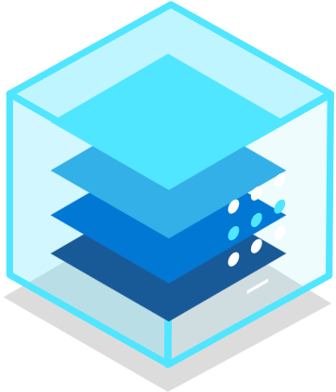



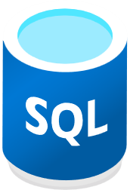

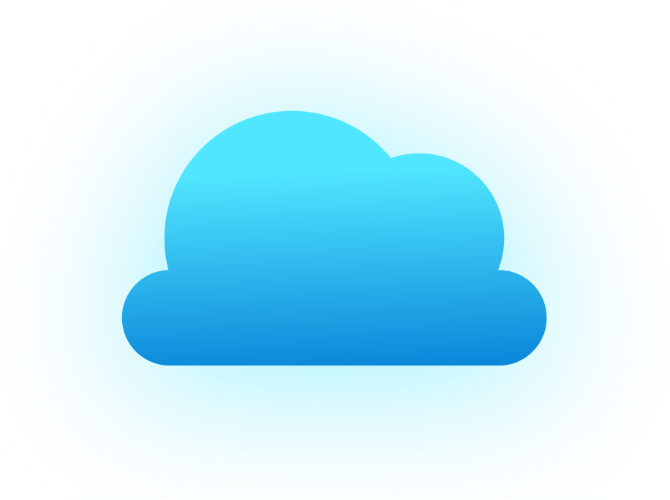

Azure Data Explorer architecture
Azure
OSS
Applications
Azure portal/Studio
Apps (via ARM)
Apache Spark
Query, control commands
Create, manage
Azure Data Factory
Apps via APIs, REST, SQL (TDS), ODBC, JDBC)
Apps via APIs
Power BI
Data management
SSD
Logstash plugin
ADX UI (+ Dashboards)
Kafka sync
Power Automate, Flow
IoT Hub
Active data connections
Azure Data Factory
Event Hub
Jupyter Notebooks
Grafana, Redash.io
Event Grid
Apache Spark
Azure Storage
Customer Data Lake (blob / ADLS Gen2)
Ingested Data
SQL
Cosmos DB
Azure Monitor
Notes:
ADX implements a scale out architecture by separating the compute and storage resources. This enables you to independently scale each resource and, for example, run multiple read only computes on the same data.
ADX consists of a set of computes running the engine that is responsible for automatically indexing, compressing, caching, and serving distributed queries.
They also have a second set of computes running the data management service responsible for background system jobs, and managed and queued data ingestion.
All data is persisted on managed blob storage accounts using a compressed columnar format.
ADX supports a rich ecosystem for ingesting data using connectors, SDKs, REST APIs, and other managed capabilities.
It offers various ways to consume data for adhoc queries, reports, dashboards, alerts, REST APIs, and SDKs.
Finally, its supports querying data from SQL, CosmosDB, Azure Monitor and Data Lake.

Slide 19
Batching vs streaming ingestion
Batching
Optimized for high ingestion throughput
Preferred method and most performant
Data is batched according to properties
Set ingestion batching policy on databases or tables
Default max batching value is 5 minutes, 1000 items or total of 1 GB
4 GB data size limit for a batch ingestion command
Streaming
Ongoing data ingestion from a streaming source
Near real-time latency for small sets of data per table
Initially ingested to row store
Then moved to column store extents
Steaming can be done using ADX client library or supported pipelines
NOTE: The recommendation is to ingest files between 100 MB and 1 GB.
See more: comparing-ingestion-methods-and-tools
Notes:
https://docs.microsoft.com/en-us/azure/data-explorer/ingest-data-overview#batching-vs-streaming-ingestion
Small batches ingested get merged and optimized behind the scenes.

Slide 20




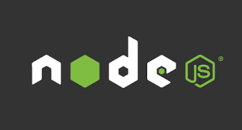




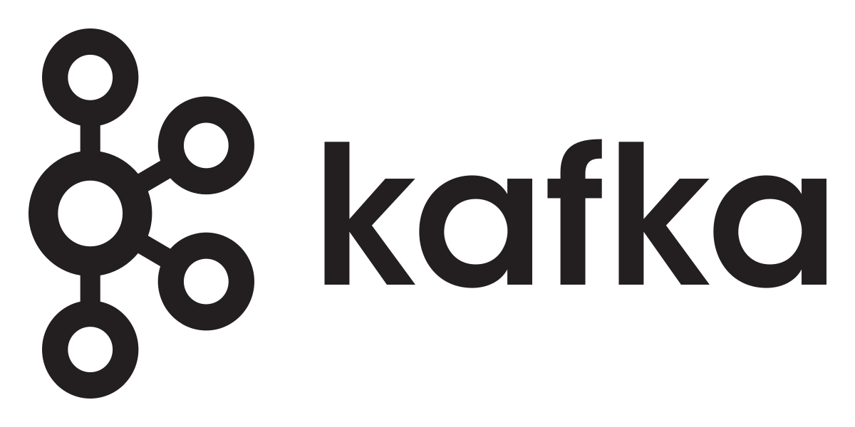




Data Management and Ingestion
1
SDKs
Managed pipelines
Data Explorer
Connections
Batching
Data Explorer
Engine
Data Management
Ingestion
Connection & plugins
Management
Tools
One Click Ingestion
LightIngest
Notes:
You can ingest data in Data Explorer in many ways.
Using our SDKs
Use managed pipelines where Data Explorer will automatically read the data from IoT Hub, EventHub or Storage\Data Lake
Use any of the 1st party connectors and agents to push data from Kafka, Spark, Logstach, PowerApp, FluentBit, and Telegraph agents
Use Azure Data Factory\Synapse Pipelines to bring data from wide variety of sources
Data Explorer support automated batching of the data for efficient ingestion and can ingest up 200 MB/sec csv files per 16 cores compute. It support wide variety of formats such as JSON, Parquet, Orc, Avro and more.
Limitations with current Data Explorer in Synapse:
IoT Hub and Event Grid managed pipelines are not supported when the workspace is created under Managed Vnet.

Slide 21
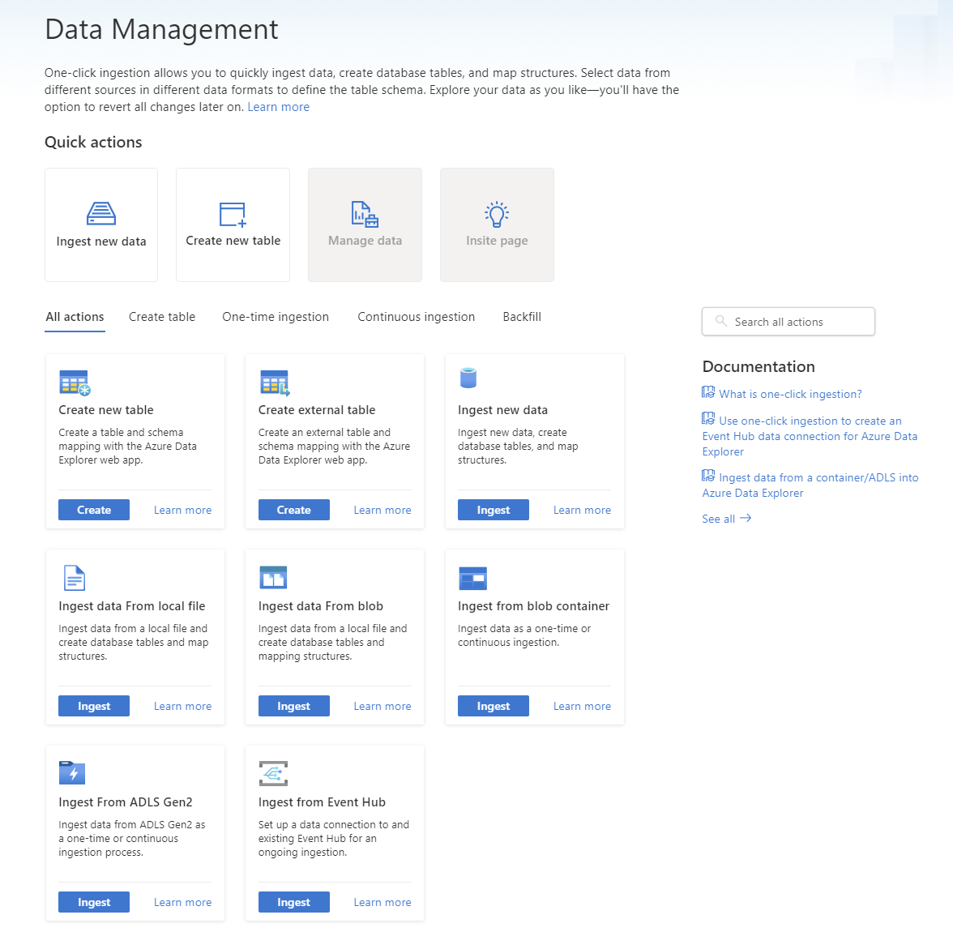
ADX Web UI One-Click (wizard)
1
Friction free on-boarding of your Azure data sources to Data Explorer
Get data from Azure Data Lake, Blob, Event Hub, or local file
Infer the schema automatically from source
Create table and mapping automatically from source
Generate custom code to start ADX project with one of the supported SDKs
Manage data-policies (e.g. retention, batching policies, streaming)
Get insight on your data management
Ingest one-time data or create connection for continuous data ingestion
Continuous (EventHub/EventGrid), one time or backfill (LightIngest)
Data Explorer
Event Grid
Event Hubs
Azure Data Lake Storage
Notes:
Slide is self-explanatory

Slide 22
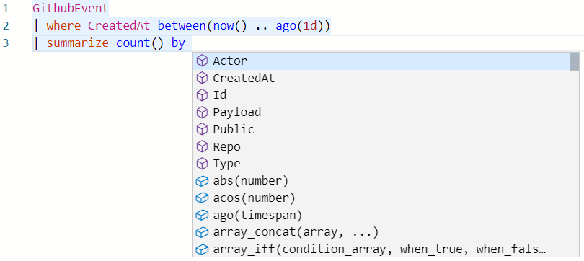
Intuitive querying
1
Simple and powerful
Rich rational query language (filter, aggregate, join, calculated columns, and more)
Built-in full-text search, time series, user analytics, geospatial, and machine learning operators
Out-of-the box visualization
Easy-to-use syntax + Microsoft IntelliSense
Highly recognizable hierarchical schema entities
Extensible
In-line Python and R
T-SQL

Slide 23
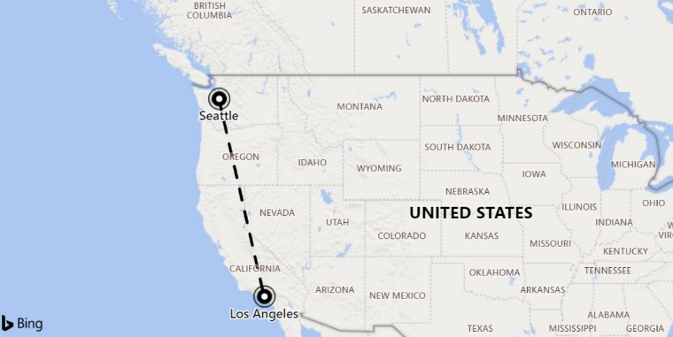
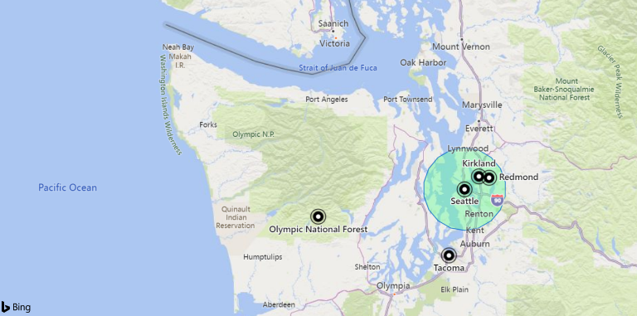
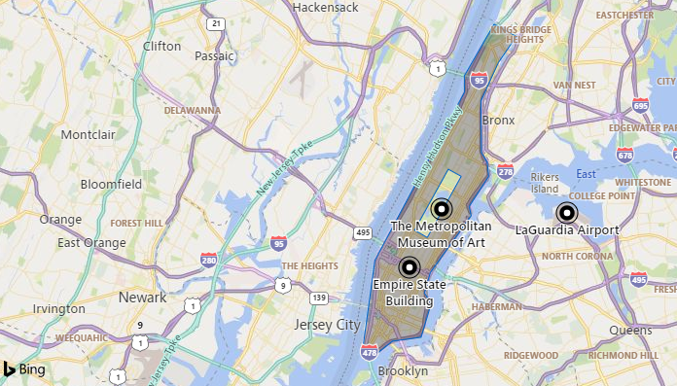
Geospatial query
1
Geohash support
Transformation from coordinates to geohashes and back
Use-case: Summarization by geographical buckets, store locations based on a single column
Distance
Calculate the distance between two points
Contains
Check whether a point is in a given circle
Next: support for lines & polygons (i.e. check whether a point/line/polygon is in a polygon)
Next: Intersection
Support for lines & polygons
Geospatial coordinates are interpreted as represented per the WGS-84 reference system.
Notes:
Geohash
https://docs.microsoft.com/en-us/azure/kusto/query/geo-point-to-geohash-function
https://docs.microsoft.com/en-us/azure/kusto/query/geo-geohash-to-central-point-function
Points in circle
https://docs.microsoft.com/en-us/azure/kusto/query/geo-point-in-circle-function
Distance
https://docs.microsoft.com/en-us/azure/kusto/query/geo-distance-2points-function

Slide 24
Advanced Analytics – Built-in & Extendible
Out of the box
Auto Clustering for Diagnosis and RCA
Anomaly Detection
Regression
Forecasting
Time Series Analysis library
Distributed Custom Code Execution
Distributed Python and R execution
Custom code is embedded in the KQL query
Spark Integration
Native Spark connector for heavy duty model training
Operationalize model into ADX for scoring
Tools
Jupyter Integration with KQL Magic
Python, Java SDKs

Slide 25

Enterprise Ready – Mission Critical
Azure Active Directory Integration
Availability Zones
Role based authorization
Auto Scale-Up/In
Network Perimeter Security
Globally available
Encryption with customer managed keys/”BYOK”
CI/CD Integration
Build Azure Policy Support
Automated provisioning
Bring Your Own Keys
Monitoring
Notes:
Azure Data Explorer is enterprise ready with all the key capabilities you need get to production.

Slide 26
Demo 2*
Thermostat data
JSON
Render
Fill gaps
Forecast
Anomalies
Dashboards
Materialized Views
External Tables
* Estimate 20 minutes
Notes:
Instructor Steps: https://dev.azure.com/CEandS/Azure-Data-Explorer/_wiki/wikis/ADX-with-IoT-Analytics/1105/Demos?anchor=module-2---adx-iot
https://youtu.be/n5wMgkQzbWw?t=273
Need a cluster, database, tables and load your data in. Best way to load is to push via the SDKs.
Occupancy Thermos
Streaming data into an Event Hub and then comes into ADX
Put them into a structure that is simple for my users to query
First comes in to StageIoTRawData
| sample 10
Look at the body column lets transform it to make it available for query.
Create or alter function extractthermostatdata
After transformation query Thermostats | sample 10
See BatteryLevel, Temp, Humidity
Then look at the avg temp every 1 minute for last 7 days in a Timechart. – This should be a wow! Then in a 10 minute bin.
Check if any missing data? Use make-series of specified aggregated values. Expand AvgTemp and see 0s.
Fill missing values using extend series fill linear – This should be another wow! ☺
Forecast temp in next hour using extend series decompose forecast
Find if any Anomaly is detected for a device using decompose anomalies with finetune threasholds for your requirements
Find if Anomalies for all devices using mv-expand
NEXT Dashboard. Click Share > Pin to Dashboard.
Go to Dashboard and show IoT Demo 01
When you see a pattern, ie. Trend with linear interpolation of missing values in a series, click ellipses, Explore Query
Can change the query and run again
This is an amazing experience to go from an Advanced User to a Reporting Experience and to an Advanced User.
https://youtu.be/n5wMgkQzbWw?t=640
Pre-agg data by hours/day/and so on. Ie. Materialized-views
.show materialized-view
For example, Hourly avg view vs Current view which uses summarize and rg_max to get the latest data in cache.
Data can be exported to a datalake for example in parquet and then queried as external_table as a multi-tiered system.
PYTHON
https://youtu.be/n5wMgkQzbWw?t=801
Create UDF to run K-Means clustering using Python plugin
Create or alter function with folder python, then query Thermostats using invoke to call the function. (Unsupervised Model)
Python runs locally on the node where the data is. Data doesn’t move out of the nodes.
Store a pretrained model and score data ie. Based on Temp and Humidity – is the room occupied? (Supervised Model)
DEMO FINISHED – next talk about how customers are using ADX in IoT scenarios if needed.
https://youtu.be/n5wMgkQzbWw?t=917

Slide 27
Migration
Lesson 3

Slide 28
Objectives
After completing this Learning, you will be able to understand:
Walkthrough key steps
Explain automation options
Importing historical

Slide 29
TSI Gen1 – Migration to ADX Key Steps
Create ADX Cluster
Set up parallel ingestion from hubs to ADX Cluster
Continue ingesting data for the period of fixed retention
Start using ADX Cluster
Delete TSI environment
Considerations
If telemetry data is required to be exported, use TSI Query API to download the events in batches and serialize in required format.
TSI Explorer or Reference Data API can be used to download reference data set and upload it into ADX as another table.
Then create materialized views in ADX can be used to join reference data with telemetry data.
Post-migration
Translate Time Series Insights Queries to KQL
Notes:
TSI Migration to ADX Steps
TSI has two offerings, Gen1 and Gen2, which have different migration steps.
TSI Gen1
TSI Gen1 doesn’t have cold storage or hierarchy capability. All data has fixed retention. Extracting data and mapping it to ADX would be complicated and time-consuming task for TSI developers and the customer. Suggestion migration path is to set up parallel data ingestion to ADX. After fixed data retention period passes TSI environment can be deleted as ADX will contain same data.
Create ADX Cluster
Set up parallel ingestion from hubs to ADX Cluster
Continue ingesting data for the period of fixed retention
Start using ADX Cluster
Delete TSI environment
The recommendation is to set up Azure Data Explorer cluster with a new consumer group from the Event Hub or IoT Hub and wait for retention period to pass and fill Azure Data Explorer with the same data as Time Series Insights environment. If telemetry data is required to be exported from Time Series Insights environment, the suggestion is to use Time Series Insights Query API to download the events in batches and serialize in required format. For reference data, Time Series Insights Explorer or Reference Data API can be used to download reference data set and upload it into Azure Data Explorer as another table. Then, materialized views in Azure Data Explorer can be used to join reference data with telemetry data. Use materialized view with arg_max() aggregation function which will get the latest record per entity.
Detailed FAQ and engineering experience is outlined in How to migrate TSI Gen1 to ADX

Slide 30
TSI Gen2 – Migration to ADX Key Steps
Get migration telemetry size, path and ingestion behavior
Migrate telemetry to ADX
Redirect TSI Live Data
Post-migration
Migrating Time Series Model (TSM) to ADX
Translate Time Series Queries (TSQ) to KQL
OPTIONAL: Migration from TSI Power BI Connector to ADX Power BI Connector
Notes:
TSI Gen2
TSI Gen2 stores all data on cold storage using Parquet format as a blob in customer’s subscription. To migrate data customer, should take the blob and import it into ADX using bulk upload capability Lightingest. More information on lightingest can be fund here.
Create ADX Cluster
Redirect data ingestion to ADX Cluster
Import TSI cold data using lightingest
Start using ADX Cluster
Delete TSI Environment
Detailed FAQ and engineering experience is outlined in How to migrate TSI Gen2 to ADX

Slide 31
Overview
Feature | TSI Gen2 State | ADX Migration Recommended
Ingesting JSON from Hub with flattening and escaping | TSI Ingestion | ADX - OneClick Ingest / Wizard, DB Data Connection from Hubs
Open Cold store | Customer Storage Account | Continuous data export to customer specified external table in ADLS.
PBI Connector | Private Preview* | Use ADX PBI Connector. Rewrite TSQ to KQL manually.
Spark Connector | Private Preview*. Query telemetry data. Query model data. | Migrate data to ADX. Use ADX Spark connector (KQLMagic) for telemetry data + export model to JSON and load in Spark. Rewrite queries in KQL.
Bulk Upload | Private Preview* | Use ADX OneClick Ingest and LightIngest. An optionally, set up partitioning within ADX.
Time Series Model | n/a | Can be exported as JSON file. Can be imported to ADX to perform joins in KQL.
TSI Explorer | Toggling warm and cold | ADX Dashboards
Query language | Time Series Queries (TSQ) | Rewrite queries in KQL. Use Kusto SDKs instead of TSI ones.
* This service will not go live as TSI will no longer be supported

Slide 32
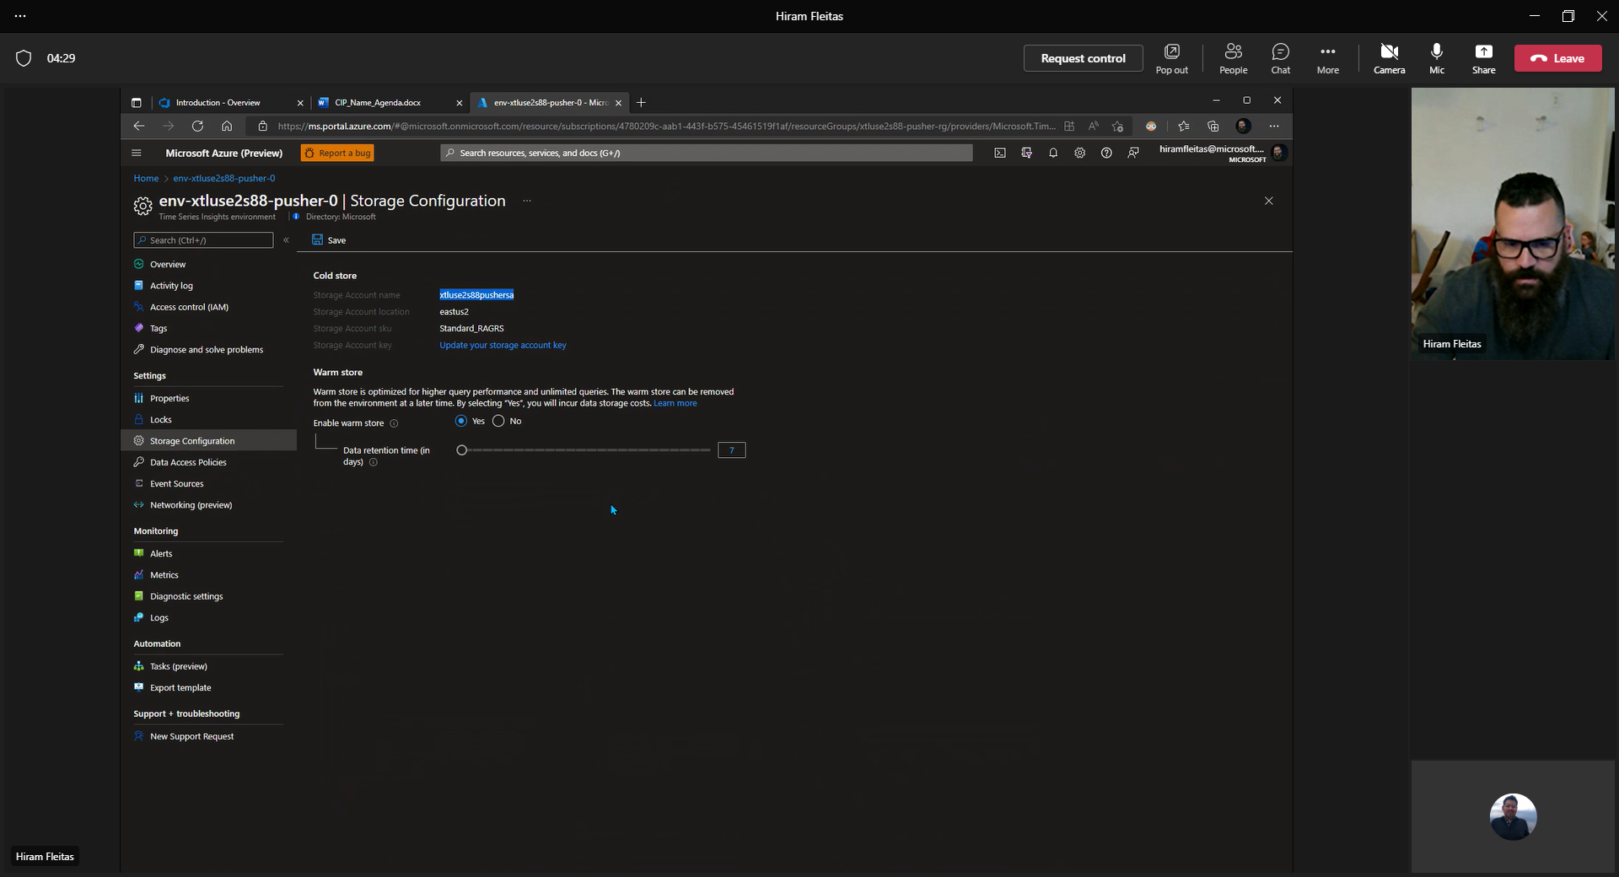
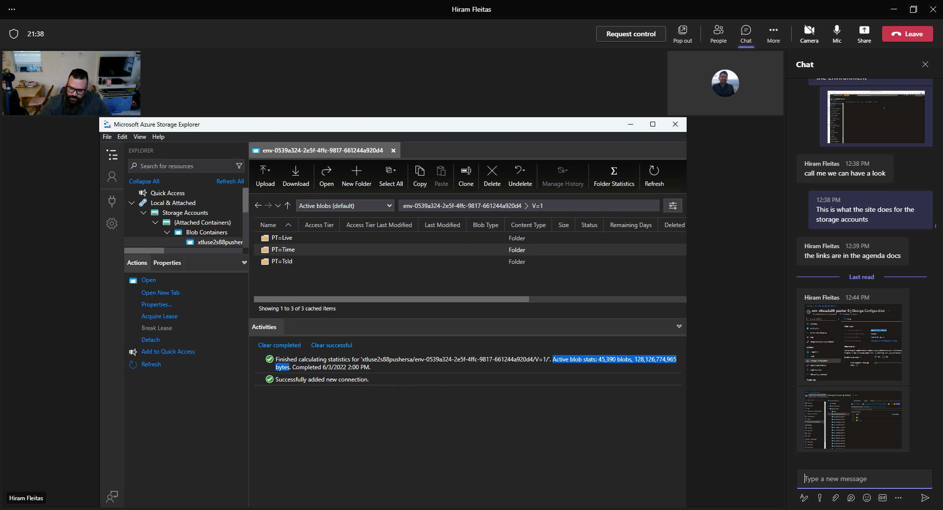
Step 1 - Migrating Telemetry Prerequisites
Sum of data size and volume to migrate
Where data is stored
If there is a lot of late arriving data in comparison to ingestion point
If TSI is Gen 2, then use PT=Time folder to retrieve historical data.
Azure portal > TSI environment > Settings > Storage Configuration.
Inside you will find a folder per environment, year & month.
Notes:
Accessing cold store data
In addition to accessing your data from the Azure Time Series Insights Explorer and Time Series Query APIs, you may also want to access your data directly from the Parquet files stored in the cold store. For example, you can read, transform, and cleanse data in a Jupyter notebook, then use it to train your Azure Machine Learning model in the same Spark workflow.
To access data directly from your Azure Storage account, you need read access to the account used to store your Azure Time Series Insights Gen2 data. You can then read selected data based on the creation time of the Parquet file located in the PT=Time folder described below in the Parquet file format section.
Parquet file format and folder structure
Parquet is an open-source columnar file format designed for efficient storage and performance. Azure Time Series Insights Gen2 uses Parquet to enable Time Series ID-based query performance at scale.
For more information about the Parquet file type, read the Parquet documentation.
Azure Time Series Insights Gen2 stores copies of your data as follows:
The PT=Time folder is partitioned by ingestion time and stores data roughly in order of arrival. This data is preserved over time and you can directly access it from outside of Azure Time Series Insight Gen2, such as from your Spark notebooks. The timestamp <YYYYMMDDHHMMSSfff> corresponds to the ingestion time of the data. The <MinEventTimeStamp> and <MaxEventTimeStamp> correspond to the range of event timestamps included in the file. The path and filename are formatted as:
V=1/PT=Time/Y=<YYYY>/M=<MM>/<BlobCreationTimestamp>_<MinEventTimestamp>_<MaxEventTimestamp>_<TsiInternalSuffix>.parquet
The PT=Live and PT=Tsid folders contain a second copy of your data, repartitioned for time series query performance at scale. This data is optimized over time and is not static. During repartitioning, some events could be present in multiple blobs and the blob names might change. These folders are used by Azure Time Series Insights Gen2 and should not be accessed directly; you should only use PT=Time for that purpose.
Note
Data in the PT=Time folder from before June 2021 could have a filename format with no event time ranges: V=1/PT=Time/Y=<YYYY>/M=<MM>/<BlobCreationTimestamp>_<TsiInternalSuffix>.parquet. The internal file format is the same and files with both naming schemes can be used together.
<YYYY> maps to a four-digit year representation.
<MM> maps to a two-digit month representation.
The <YYYYMMDDHHMMSSfff> format of the timestamps map to a four-digit year (YYYY), two-digit month (MM), two-digit day (DD), two-digit hour (HH), two-digit minute (MM), two-digit second (SS), and three-digit millisecond (fff).
Azure Time Series Insights Gen2 events are mapped to Parquet file contents as follows:
Each event maps to a single row.
Every row includes the timestamp column with an event time stamp. The time-stamp property is never null. It defaults to the event enqueued time if the time stamp property isn't specified in the event source. The stored time-stamp is always in UTC.
Every row includes the Time Series ID (TSID) column(s) as defined when the Azure Time Series Insights Gen2 environment is created. The TSID property name includes the _string suffix.
All other properties sent as telemetry data are mapped to column names that end with _bool (boolean), _datetime (time stamp), _long (long), _double (double), _string (string), or _dynamic (dynamic), depending on the property type. For more information, read about Supported data types.
This mapping schema applies to the first version of the file format, referenced as V=1, and stored in the base folder of the same name. As this feature evolves, this mapping schema might change and the reference name incremented.

Slide 33
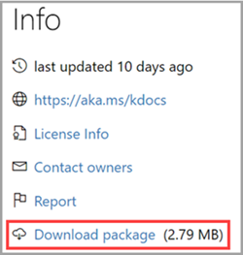
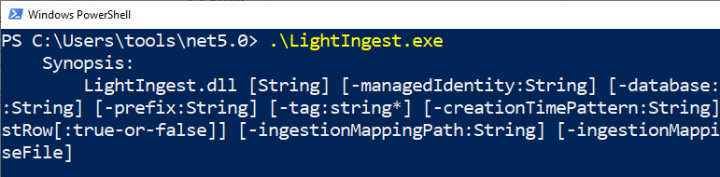
Con’t
Download LightIngest
Review if there is significant late arriving data. (very unlikely)
Review blob files in PT=Time subfolder of the TSI storage account(s).
Compare when blob is created to min event using the filename format: <BlobCreationTimestamp>_<MinEventTimestamp>_<MaxEventTimestamp>_*.parquet
If BlobCreation is far from MinEvent for a lot of files, then there’s a lot of late arriving data.
If true, then use ADX data partitioning policy before we ingest the data.
Notes:
Partitioning policy
The partitioning policy defines if and how extents (data shards) should be partitioned for a specific table or a materialized view. The main purpose of the partitioning policy is to improve performance of queries in specific scenarios.
Detailed FAQ and engineering experience is outlined in Partitioning policy - Azure Data Explorer | Microsoft Docs

Slide 34
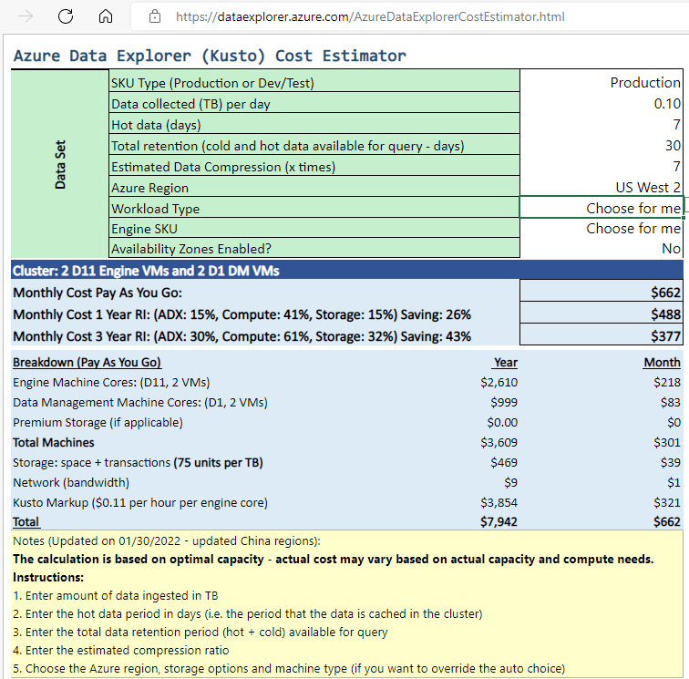
Step 2 - Prep ADX Cluster
Create the ADX Cluster
Size your cluster for your data
Estimate cost
Consider growth
Consider more nodes during migration
Enable Diagnostics
Set data partitioning (if needed)
If non-default ADX partitioning is needed, then don’t use -CreationTimePattern flag in LightIngest.exe tool.
Notes:
Migration Step 2 – Migrate Telemetry To ADX
Create ADX cluster
Define the cluster size based on data size using the ADX Cost Estimator.
From Event Hubs (or IoT Hub) metrics, retrieve the rate of how much data it's ingested per day. From the Storage Account connected to the TSI environment, retrieve how much data there is in the blob container used by TSI. This information will be used to compute the ideal size of an ADX Cluster for your environment.
Open the Azure Data Explorer Cost Estimator and fill the existing fields with the information found. Set “Workload type” as “Storage Optimized”, and "Hot Data" with the total amount of data queried actively.
After providing all the information, Azure Data Explorer Cost Estimator will suggest a VM size and number of instances for your cluster. Analyze if the size of actively queried data will fit in the Hot Cache. Multiply the number of instances suggested by the cache size of the VM size, per example:
Cost Estimator suggestion: 9x DS14 + 4 TB (cache)
Total Hot Cache suggested: 36 TB = [9x (instances) x 4 TB (of Hot Cache per node)]
More factors to consider:
Environment growth: when planning the ADX Cluster size consider the data growth along the time.
Hydration and Partitioning: when defining the number of instances in ADX Cluster, consider extra nodes (by 2-3x) to speed up hydration and partitioning.
For more information about compute selection, see Select the correct compute SKU for your Azure Data Explorer cluster.
To best monitor your cluster and the data ingestion, you should enable Diagnostic Settings and send the data to a Log Analytics Workspace.
In the Azure Data Explorer blade, go to “Monitoring | Diagnostic settings” and click on “Add diagnostic setting”
Fill in the following
Diagnostic setting name: Display Name for this configuration
Logs: At minimum select SucceededIngestion, FailedIngestion, IngestionBatching
Select the Log Analytics Workspace to send the data to (if you don’t have one you’ll need to provision one before this step)
Data partitioning.
For small size data, the default ADX partitioning is enough. For more complex scenario, with large datasets and right push rate custom ADX data partitioning is more appropriate. Data partitioning is beneficial for scenarios, as follows:
Improving query latency in big data sets.
When querying historical data.
When ingesting out-of-order data.
The custom data partitioning should include:
The timestamp column, which results in time-based partitioning of extents.
A string-based column, which corresponds to the Time Series ID with highest cardinality.

Slide 35
Step 3 - Migrate Telemetry to ADX
Prep for Data Ingestion
Go to https://dataexplorer.azure.com.
Copy the LightIngest command and store it somewhere so you can use it in the next step.
Execute Data Ingestion.
Option 1: Ingest All Data. For smaller environments.
Option 2: Ingest Data by Year or Month. For larger environments.
Monitor Ingestion.
IMPORTANT: use the -dontWait flag in LightIngest command.
Use the Insights tab via Azure Portal for the ADX cluster to monitor ingestion progress.
Ingestion is complete once metrics go to 0 for source table.
Notes:
Migration Step 2 – Migrate Telemetry To ADX
Prepare for Data Ingestion
Go to https://dataexplorer.azure.com.
Go to Data tab and select ‘Ingest from blob container’
Select Cluster, Database, and create a new Table with the name you choose for the TSI data
Select Next: Source
In the Source tab select:
Historical data
“Select Container”
Choose the Subscription and Storage account for your TSI data
Choose the container that correlates to your TSI Environment
Select on Advanced settings
Creation time pattern: '/'yyyyMMddHHmmssfff'_'
Blob name pattern: *.parquet
Select on “Don’t wait for ingestion to complete”
Under File Filters, add the Folder path V=1/PT=Time
Select Next: Schema
Note
TSI applies some flattening and escaping when persisting columns in Parquet files. See these links for more details: flattening and escaping rules, ingestion rules updates.
If schema is unknown or varying
Remove all columns that are infrequently queried, leaving at least timestamp and TSID column(s).
Add new column of dynamic type and map it to the whole record using $ path.
Example:
If schema is known or fixed
Confirm that the data looks correct. Correct any types if needed.
Select Next: Summary
Copy the LightIngest command and store it somewhere so you can use it in the next step.
Data Ingestion
Before ingesting data you need to install the LightIngest tool. The command generated from One-Click tool includes a SAS token. It’s best to generate a new one so that you have control over the expiration time. In the portal, navigate to the Blob Container for the TSI Environment and select on ‘Shared access token’
Note
It’s also recommended to scale up your cluster before kicking off a large ingestion. For instance, D14 or D32 with 8+ instances.
Set the following
Permissions: Read and List
Expiry: Set to a period you’re comfortable that the migration of data will be complete
Select on ‘Generate SAS token and URL’ and copy the ‘Blob SAS URL’
Go to the LightIngest command that you copied previously. Replace the -source parameter in the command with this ‘SAS Blob URL’
Option 1: Ingest All Data. For smaller environments, you can ingest all of the data with a single command.
Open a command prompt and change to the directory where the LightIngest tool was extracted to. Once there, paste the LightIngest command and execute it.
Option 2: Ingest Data by Year or Month. For larger environments or to test on a smaller data set you can filter the Lightingest command further.
By Year: Change your -prefix parameter
Before: -prefix:"V=1/PT=Time"
After: -prefix:"V=1/PT=Time/Y=<Year>"
Example: -prefix:"V=1/PT=Time/Y=2021"
By Month: Change your -prefix parameter
Before: -prefix:"V=1/PT=Time"
After: -prefix:"V=1/PT=Time/Y=<Year>/M=<month #>"
Example: -prefix:"V=1/PT=Time/Y=2021/M=03"
Once you’ve modified the command, execute it like above. One the ingestion is complete (using monitoring option below) modify the command for the next year and month you want to ingest.
Monitoring Ingestion
The LightIngest command included the -dontWait flag so the command itself won’t wait for ingestion to complete. The best way to monitor the progress while it’s happening is to utilize the “Insights” tab within the portal. Open the Azure Data Explorer cluster’s section within the portal and go to ‘Monitoring | Insights’
You can use the ‘Ingestion (preview)’ section with the below settings to monitor the ingestion as it’s happening
Time range: Last 30 minutes
Look at Successful and by Table
If you have any failures, look at Failed and by Table
You’ll know that the ingestion is complete once you see the metrics go to 0 for your table. If you want to see more details,, you can use Log Analytics. On the Azure Data Explorer cluster section select on the ‘Log’ tab:

Slide 36
Step 4 - Redirect TSI Live Data
Data will be flowing into TSI via EventHub or IoTHub.
Ingest live data by creating a data connection (managed pipeline) to the ADX database table
Create another consumer group on EventHub and IoTHub
Setting up the ADX Data Connection using the new consumer group.
Option 1: Historical data & Hot data in same table.
Benefit: Single table simplifies the process and queries.
Considerations:
Almost certainly leads to duplicate data, then handle duplicate data in ADX.
Less flexible than option 2.
Option 2: Historical data & Hot data in 2 separate tables.
Use one-click ingestion to ingest data from EventHub into Azure Data Explorer.
Create a KQL function to unify the data using union.
Notes:
TSI Live Data
At this point, it is necessary to define how we will connect to the hot path data flowing into TSI. Data will be flowing into TSI via EventHub or IoTHub so we will need to create a managed pipeline to ADX to ingest this data.
To collect this data, you will create another consumer group on EventHub and IoTHub and use that consumer group when setting up the ADX Managed Pipeline. There are two options that we will cover here on how to handle the ingestion in ADX.
Option 1: Historical Data and Hot Data in Same Table
Benefit: Having a single table simplifies the process for migration
Considerations: This almost certainly lead to duplicate data. Data you ingest from EventHub is still going to TSI so that data will make it’s way to the PT=Time folder than you are also ingesting. This is not a flexible option as option 2 is.
Option 2: Historical Data Table and Hot Data Table
Ingest the two paths into two separate tables then use a union to bring the data together. Easiest way to explain is to walk through an example:
Historical data is ingested from the PT=Time and PT=Import folders and put into a table named TSIHistorical. As an example, we ingest data here all the way through 3/22
Hot path data is ingested from Azure Event Hub and put int a table named TSIData. As an example, we initialize this connection at some point on 3/21
Example query to union these two table together
TSIData
| where TS >= datetime(2022-03-22)
| union (TSIHistorical
| where TS < datetime(2022-03-22)
Create a function that will execute this function. You can name the function the same as the hot path data to simplify queries. For example, if you name the function TSIData, querying this function will return all the current and historical data.

Slide 37
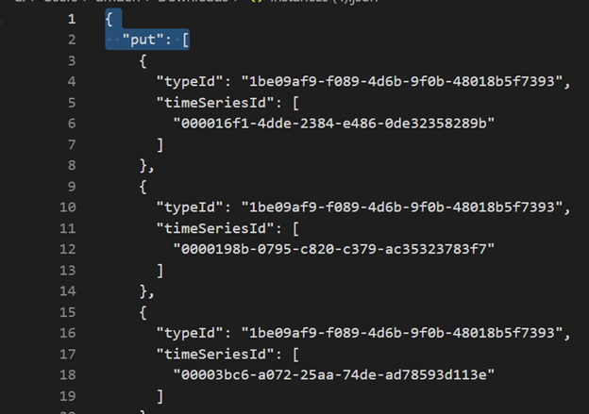
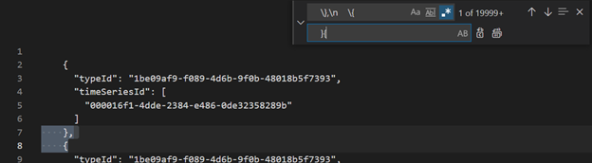
Step 5 - Migrating TSI Model (TSM) to ADX
Download models in JSON format via TSI Explorer UX or TSM Batch API.
Edit it using VSCode or another editor.
Search and replace as regex \},\n \{ with }{.
Ingest JSON file to separate ADX table via ADX One-Click UI.
Notes:
Migrating Time Series Model (TSM) to Azure Data Explorer
The model can be download in JSON format from TSI Environment using TSI Explorer UX or TSM Batch API. Then the model can be imported to another system like Azure Data Explorer.
Download TSM from TSI UX.
Delete first three lines using VSCode or another editor.
Using VSCode or another editor, search and replace as regex \},\n \{ with }{
Ingest as JSON into ADX as a separate table using Upload from file functionality.

Slide 38
Step 5 - Rewrite TSQ to KQL (example)
{
"aggregateSeries": {
"timeSeriesId": [
"deviceId1"
],
"searchSpan": {
"from": "2021-11-01T00:00:00.0000000Z",
"to": "2021-11-05T00:00:00.0000000Z"
},
"filter": {
"tsx": "$event.sensors.sensor.String = 'heater' AND $event.sensors.location.String = 'floor1room12'"
},
"interval": "PT1M",
"inlineVariables": {
"sensor": {
"kind": "numeric",
"value": {
"tsx": "coalesce($event.sensors.value.Double, todouble($event.sensors.value.Long))"
},
"aggregation": {
"tsx": "avg($value)"
}
}
},
"projectedVariables": [
"sensor"
]
}
}
events
| where timestamp >= datetime(2021-11-01T00:00:00.0000000Z) and timestamp < datetime(2021-11-05T00:00:00.0000000Z)
| where deviceId_string == "deviceId1"
| where ['sensors.sensor_string'] == "heater" and ['sensors.location_string'] == "floor1room12"
| summarize avgSensorValue= avg(coalesce(['sensors.value_double'], todouble(['sensors.value_long']))) by bin(IntervalTs = timestamp, 1m)
| project IntervalTs, avgSensorValue
Notes:
Translate Time Series Queries (TSQ) to KQL
There are several examples to migrate TSQ to KQL. You can look on all them at https://docs.microsoft.com/en-us/azure/time-series-insights/how-to-tsi-gen2-migration#translate-time-series-queries-tsq-to-kql.

Slide 39
Step 6 - Migrate Reports to ADX (optional)
Power BI
TSI Connector to ADX Connector, manual steps involved:
Convert Power BI query to TSQ
Convert TSQ to KQL Power BI
See more: migration-from-tsi-power-bi-connector-to-adx-power-bi-connector
Notes:
Migration from TSI Power BI Connector to ADX Power BI Connector
The manual steps involved in this migration are
Convert Power BI query to TSQ
Convert TSQ to KQL Power BI
This task requires deeper understand on TSQ and KQL to successfully translate TSQ query to KQL. Go to https://docs.microsoft.com/azure/time-series-insights/how-to-tsi-gen2-migration#migration-from-tsi-power-bi-connector-to-adx-power-bi-connector for further examples.

Slide 40
Demo 3*
Setup ADX
Setup table + mapping
Setup LightIngest
Setup ADF
Setup ADF pipelines, etc
* Estimate 20 minutes
Notes:
Instructor Steps: https://dev.azure.com/CEandS/Azure-Data-Explorer/_wiki/wikis/ADX-Onboarding/1932/Demos

Slide 41
Demo 4*
Execute LightIngest
.show commands to monitor
ADX Insights (Ingestion)
Trigger ADF pipelines, etc
Monitor ADF pipelines
* Estimate 20 minutes
Notes:
Instructor Steps: https://dev.azure.com/CEandS/Azure-Data-Explorer/_wiki/wikis/ADX-Onboarding/1932/Demos

Slide 42
Finalization
Lesson 4

Slide 43
Objectives
After completing this Learning, you will be able to understand:
Finalize changes that you have made from TSI to ADX
Resource cleanup
Final testing of ADX to ensure that all your data is migrated
Notes:
Map:

Slide 44
Beyond data migration and visual recreation
If you were using TSI API, you will need to change your application to use ADX API
ADX provides a private endpoint and disables public access feature so you will need to adjust consumer applications accordingly or use gateways to ensure that the consumers can query data from ADX
It is advisable to keep the TSI environment for 1 to 2 weeks after all the data has been migrated to ensure that you can still retrieve any missing data

Slide 45
Resource cleanup
Delete TSI environment after you have tested and used ADX sufficiently and are confident that most of your use cases are being fulfilled by ADX
ADF Pipelines
If you used ADF pipelines to migrate data from TSI to ADX, you can cleanup the pipelines after the TSI environment has been deleted
LightIngest
If you used a separate VM to run LightIngest, you can cleanup this VM
PBI to TSI
If you created a new PBI report to connect to ADX, then you can archive the old PBI report that connected to TSI

Slide 46
ADX usage monitoring and optimization
Use Insights blade in ADX to monitor the usage pattern of ADX
Use the Advisor recommendations and cluster boundedness recommendations to adjust the SKU, size and node count of the ADX cluster to ensure that your costs stay in control
Implement stop-start script to control ADX costs for usage outside business hours
This can have implication on how data is ingested into ADX. So, discuss this with your CSA/CE before deciding to implement this.

Slide 47
Post Data Migration
Verify all the data was migrated
Check data in Log Analytics for Successful Ingestion and verify it matches with data on blob for historical data. For example, this will provide the number of blobs ingested:
SucceededIngestion
| where Table == 'TSITelemetry'
| summarize dcount(IngestionSourcePath)
Run some basic KQL queries to explore the data in ADX
Start building visualization based on decision on which option to utilize
Configure RBAC on the ADX database to provide needed permissions

Slide 48
Demo 5* - Visualization Options
Power BI: Connected Devices - Power BI
ADX Dashboard: ADT Integration Demo (azure.com)
Grafana: Patient Monitoring with ADT - Grafana (azgrafana.io)
TSI JavaScript Controls: Time Series Insights JavaScript SDK Examples (tsiclientsample.azurewebsites.net)
Seeq: Microsoft Azure Data Explorer (ADX) Connector - Seeq Knowledge Base - Confluence (atlassian.net)
* Estimate 20 minutes
Notes:
Instructor Steps: https://dev.azure.com/CEandS/Azure-Data-Explorer/_wiki/wikis/ADX-Onboarding/1932/Demos

Slide 49
Summary
Lesson 1: Why TSI to ADX migration
Lesson 2: Understanding ADX
Lesson 3: Migrating from TSI to ADX
Lesson 4: Finalizing the migration
Notes:
https://microsoft.sharepoint.com/teams/CSUDataAICommunityIPLibrary/_layouts/15/Doc.aspx?sourcedoc=%7B318D6B89-8C3F-41F6-8F1A-7F737AE7567B%7D&file=CIP_Name_Agenda.docx&action=default&mobileredirect=true&share=IQGJa40xP4z2QY8af3N651Z7AXwr0sZRYb0IxoCqtkhi1QQ&cid=8d6e2bf3-6b6b-4291-a2b6-481656135131
Lesson 1: 30 mins
Lesson 2: 60 mins
Lesson 3: 60 mins
Lesson 4: 45 mins

Slide 50
Resources
Migration docs: aka.ms/tsi2adx
Keep up with news: aka.ms/adx.blog
Learn more: aka.ms/adx.iot
Free online courses: Azure Data Explorer (pluralsight.com)
Technical Whitepaper: azure.microsoft.com/resources/azure-data-explorer
IoT Reference Architecture: docs.microsoft.com/azure/architecture/solution-ideas/articles/iot-azure-data-explorer

Slide 51
Thank You
aka.ms/adx.tsi.eval

